Slide 1
Learn to teach, for goodness sake. How RStudio certification is changing my teaching methods.
Mike K Smith, Pfizer R&D UK Ltd

Slide 2
This talk is for YOU…
If you are looking for an R trainer and want to know what "RStudio certification" means
If you are interested in becoming an RStudio certified trainer
If you are creating training materials for others

Slide 3
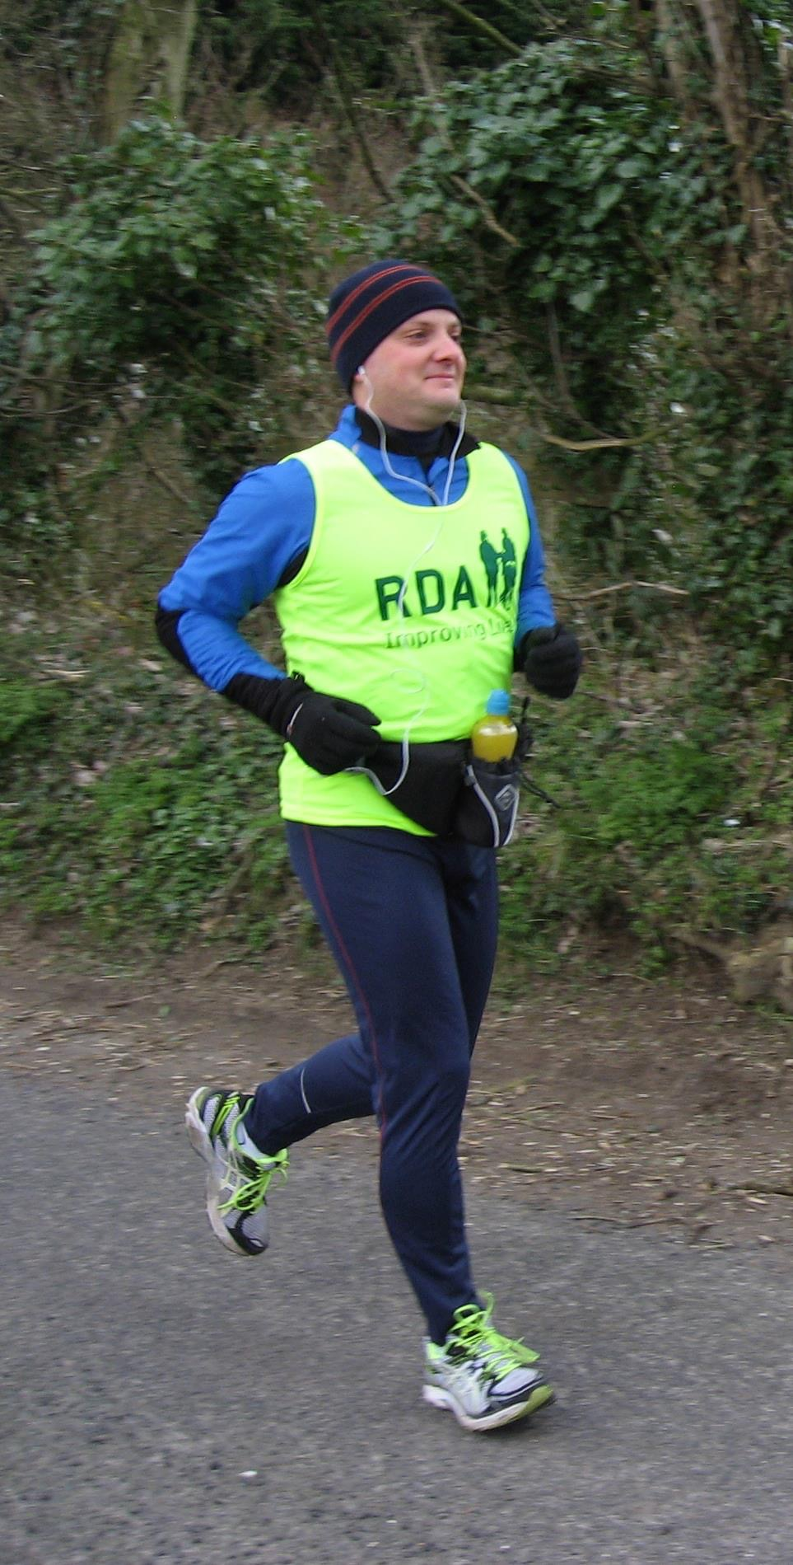
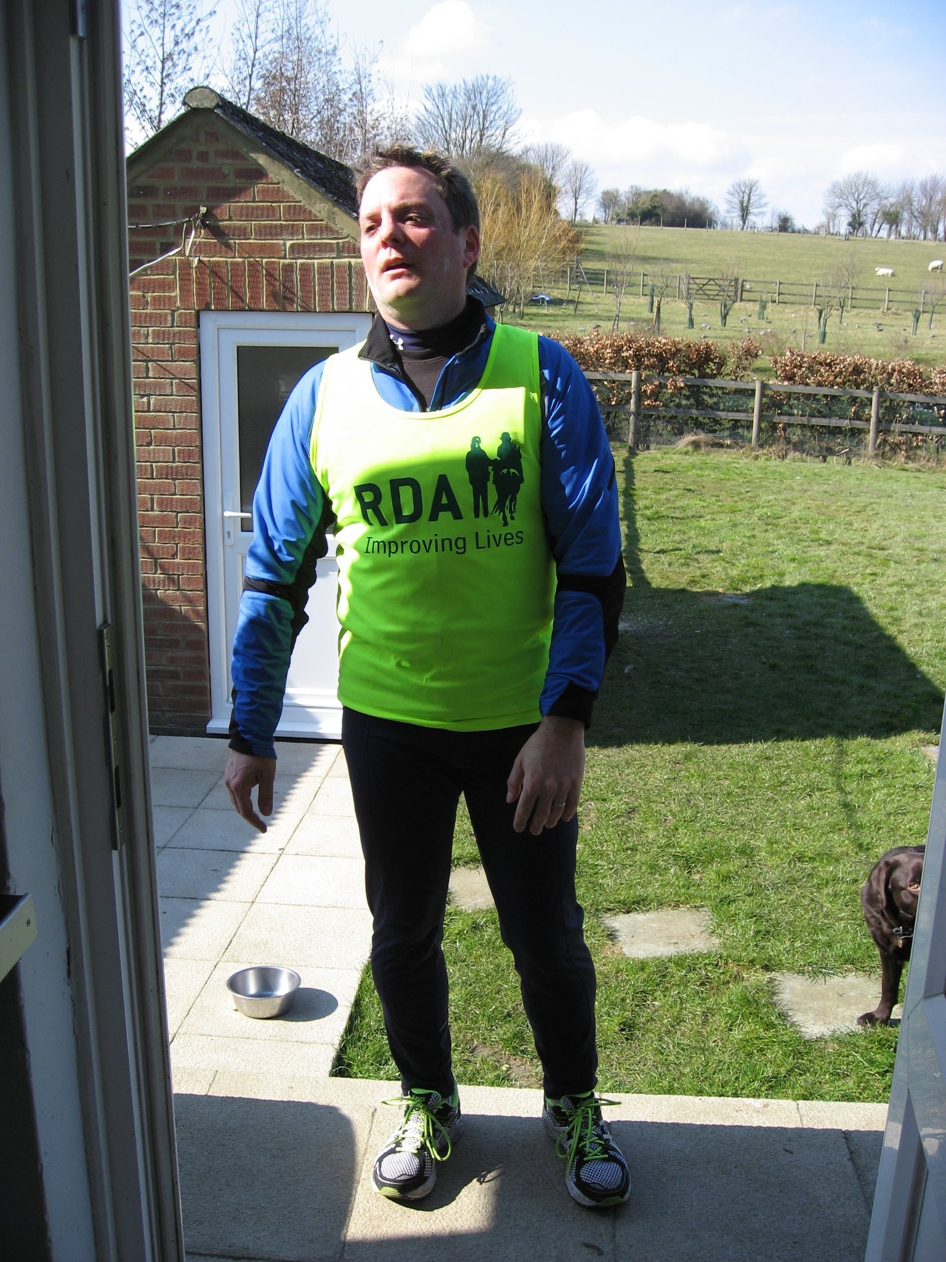
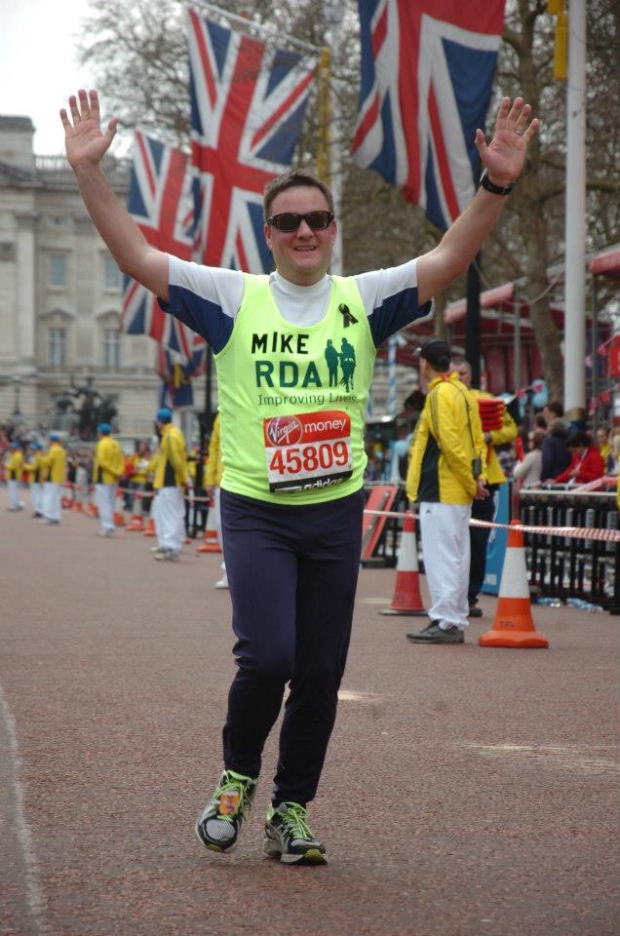
An analogy: learning and teaching others R is a bit like training for and running a marathon
OMG, why is
it SO HARD??
(miles 8 - 26)
I can DO this!
(first 100 yards)
I DID IT!!
(last 100 yards)

Slide 4
There’s more to teaching R than “simply” telling others how YOU do R…
Notes:
MY marathon training plan won't necessarily help YOU achieve your goals, so why do we often teach others R the way that WE have learned R?

Slide 5
Certification training has changed how I approach training others…
Notes:
I'd like to share some of the concepts from the certification training that I have found helpful in rethinking how I approach teaching R… With analogies towards running and marathons.

Slide 6
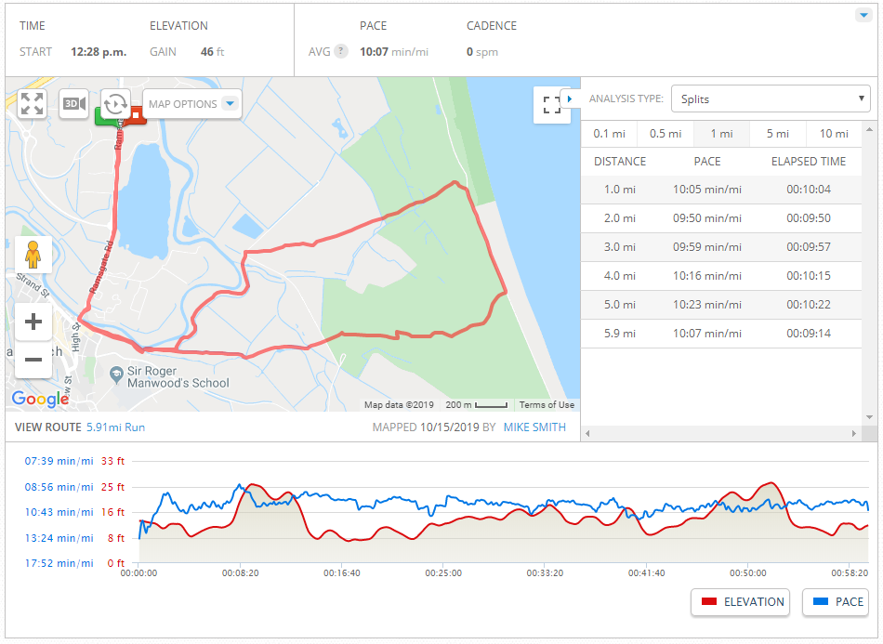
Plan your route: how far you are going, how long it will take.
Notes:
Before you run, it's best of you have planned a route – you know distance, elevation and rough timing

Slide 7
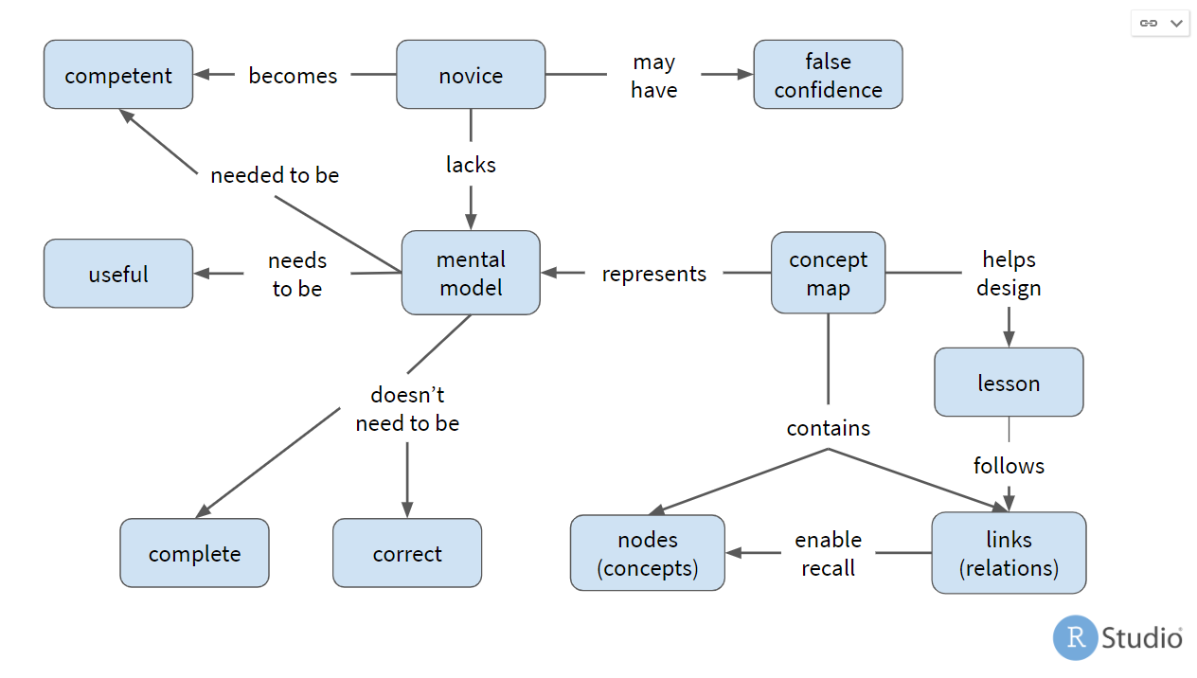
Plan your training: how many topics are you covering, how concepts relate to each other.
Notes:
Likewise, before you teach, you ought to have a plan of the concepts that you're going to introduce and how they relate to each other. It helps YOU (the trainer) plan and it helps your trainees understand how concepts are related.

Slide 8
Structure training to build on earlier training sessions…
Week 1 | 15 minutes jogging. | Rest | 20 mins jogging. | Rest | Rest | 25 mins jogging. | 1 hour ramble
Week 2 | 25 mins jogging | Rest | 35 mins jogging | Rest | Rest | 30 mins jogging | 75-min ramble
Week 3 | 30 mins jogging | Rest | 40 mins jogging | Rest | Rest | 35 mins jogging | 90-min ramble
Week 4 | 35 mins jogging | Rest | 45 mins jogging | Rest | Rest | 35 mins jogging | 1 hr jogging and walking.
Week 5 | 20-min run | Rest | 50 mins jogging | Rest | Rest | Timed run over a 2M course | 90-min ramble, or run in a 10K road race
Notes:
You should have a training plan mapped out (for each session or across training topics) and each session should build on the previous session.

Slide 9
Allow learners time to assimilate what you've taught and prepare for the next topic …
Week 1 | 15 minutes jogging. | Rest | 20 minutes jogging. | Rest | Rest | 25 minutes jogging. | 1 hour ramble
Week 2 | 25 mins jogging | Rest | 35 mins jogging | Rest | Rest | 30 mins jogging | 75-min ramble
Week 3 | 30 mins jogging | Rest | 40 mins jogging | Rest | Rest | 35 mins jogging | 90-min ramble
Week 4 | 35 mins jogging | Rest | 45 mins jogging | Rest | Rest | 35 mins jogging | 1 hr jogging and walking.
Week 5 | 20-min run | Rest | 50 mins jogging | Rest | Rest | Timed run over a 2M course | 90-min ramble, or run in a 10K road race
Notes:
In a marathon training plan you typically find lots of rest days. These are vital to ensure that you don't overdo your training. Rest is VITAL.

Slide 10
… and use planned assessments to check progress.
Week 1 | 15 minutes jogging. | Rest | 20 minutes jogging. | Rest | Rest | 25 minutes jogging. | 1 hour ramble
Week 2 | 25 mins jogging | Rest | 35 mins jogging | Rest | Rest | 30 mins jogging | 75-min ramble
Week 3 | 30 mins jogging | Rest | 40 mins jogging | Rest | Rest | 35 mins jogging | 90-min ramble
Week 4 | 35 mins jogging | Rest | 45 mins jogging | Rest | Rest | 35 mins jogging | 1 hr jogging and walking.
Week 5 | 20-min run | Rest | 50 mins jogging | Rest | Rest | Timed run over a 2 mile course | 90-min ramble, or run in a 10K road race
Notes:
In our marathon training plan, we have assessments to benchmark performance and help assess whether the training we're doing is working. Build in checks to your R training to check and measure whether your learners are actually grasping the topic.

Slide 11
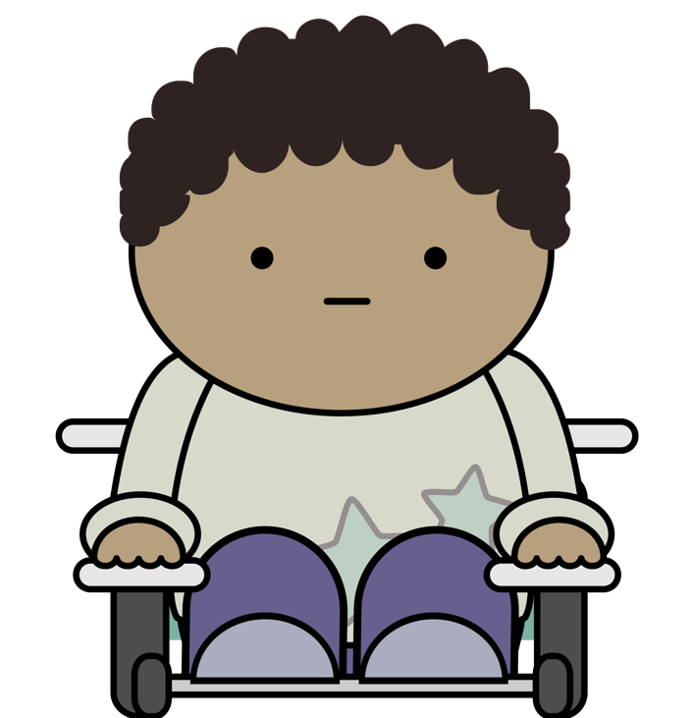


Each training session should help individuals attending towards achieving their goal.
Jacqui Ofalltrades
Exton Excel
Nang Newbie
https://github.com/rstudio-education/learner-personas
Notes:
We all have different expectations, needs and desired outcomes from training. So before we formulate training, identify likely personas and what THEY might want from training. Then ensure that what we're training fulfils the needs of those individuals.

Slide 12
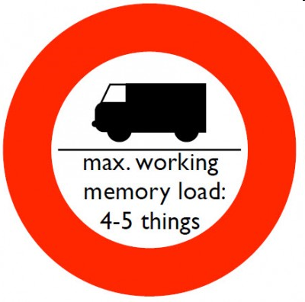
Doing too much too soon can lead to injury…
Notes:
Doing too much in one training session can lead to overload, burn out and injury (either to your learners or to yourself when they react badly to the session!)

Slide 13
The first time you run a mile is a BIG deal.
Notes:
Don't forget what it's like to approach topics from first principles.

Slide 14
But by the time you can run for 6 miles, 3 miles is an “easy session”.

Slide 15
The journey - IDEAL
Achieve THEIR goals
As quickly as possible
I can DO this!
I DID IT!!

Slide 16


Find out more
Find a certified trainer near you:
https://education.rstudio.com/trainers#people
Become a certified trainer:
https://education.rstudio.com/trainers#info
Instructor training in February 2020. Contact Greg Wilson or Carl Howe at RStudio.
RStudio Education material (CC-BY-SA license)
https://github.com/rstudio-education
 @MikeKSmith
MikeKSmith
Mike.K.Smith@Pfizer.com

